Slide 1
AI-Based Smart Food Redistribution System for People & Animals
Theme: Sustainable Living & Environment
Presented by:
Reha Gaundalkar & Prashila Gaude

Slide 2




Problem Overview
Proposed Solution
System Workflow
Impact & Benefits

Slide 3
Problem?
During festivals and large events such as Ganesh Chaturthi, weddings, and community functions, a huge amount of edible food is wasted.
People want to donate leftover food but don’t know where or how to do it quickly
Delay leads to food spoilage and unsafe consumption
Meanwhile, NGOs, underprivileged communities and gaushalas still face food shortages
The result of this, Valuable food is wasted while people and animals remain hungry.

Slide 4
Why it is a Serious Issue?
Food wastage increases significantly during festivals and events
Wasted food contributes to environmental pollution and landfill waste
Manual donation methods are slow and unorganized
There is no intelligent system to decide where the food should go and how fast
"It's not a Food Shortage Problem, it's a Coordination and Timing Problem"

Slide 5
Existing Methods & Limitations
Methods
Phone calls to NGOs
Posting on social media
Local contacts and volunteers
Limitations
No real-time matching
No food safety or usability assessment
No alternative plan if human donation is not possible

Slide 6
Solution?
We propose an AI-Based Smart Food Redistribution System that connects food donors with nearby NGOs or gaushalas.
This will:
Collect food details from donors
Use AI to analyze food type and usability
Suggest the nearest and most suitable donation option
Ensure ethical redirection when human donation is unsafe
The GOAL is to Redistribute food in Fast, Safe and Responsible manner.

Slide 7
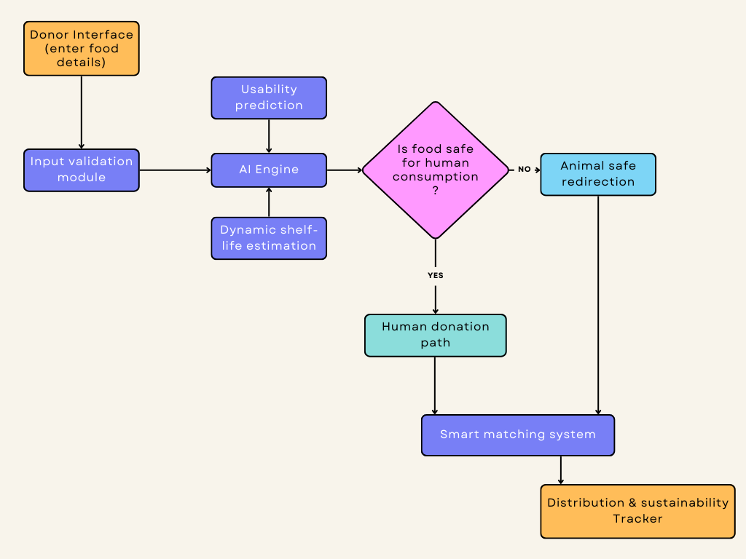
System Workflow

Slide 8
Impact & Benefits
Reduces food wastage during festivals and events.
Supports NGOs and Gaushalas.
Saves time through help of AI.
Promotes sustainable and responsible food practices.

Slide 9
Conclusion
AI used for sustainability.
By redistributing surplus food we reduce waste and support communities.

Slide 10
Thank you

